Slide 1
Object Oriented Programming Fundamentals

Slide 2
Agenda
Identifying classes from requirements
Separating responsibilities.
Defining relationships between classes
Lavage reuse

Slide 3
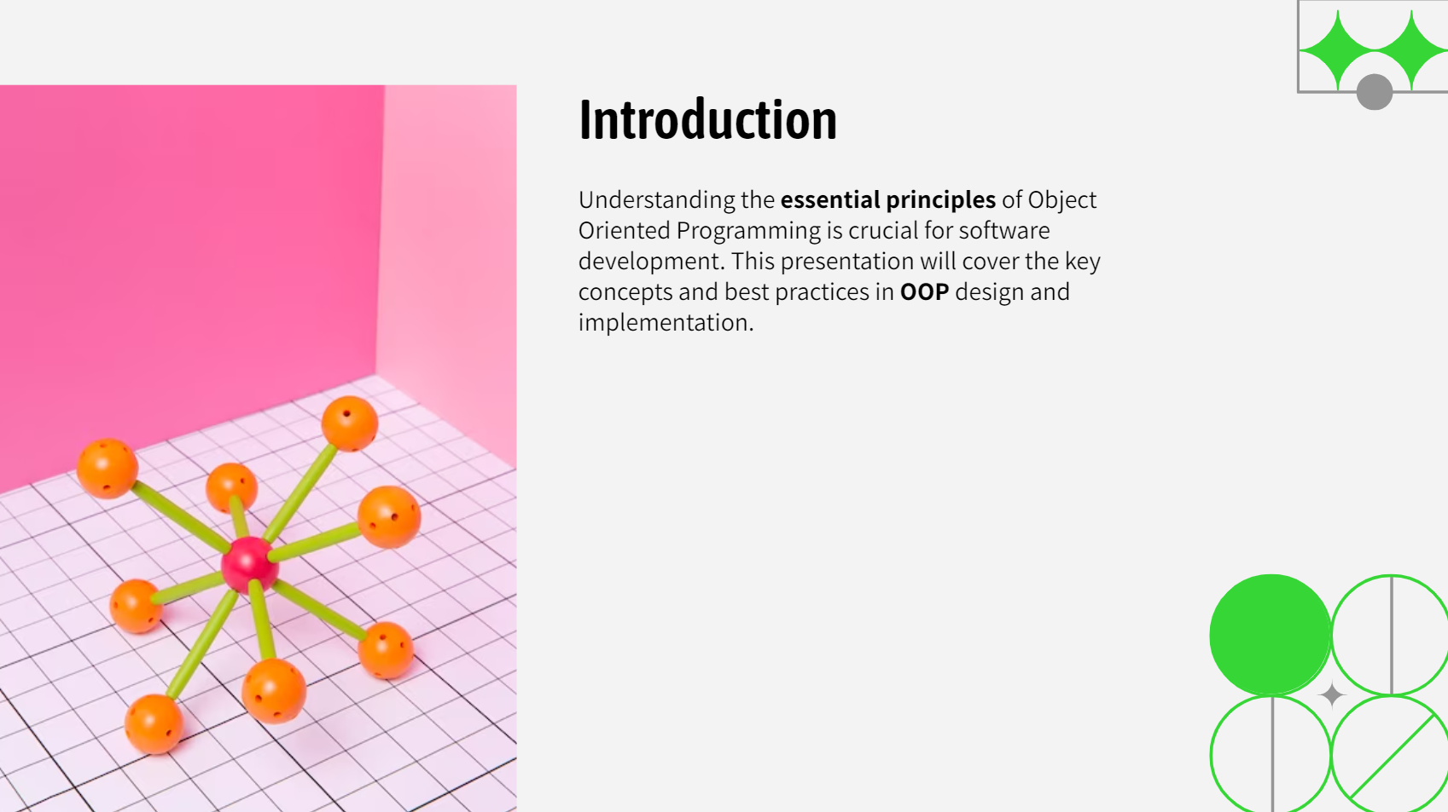
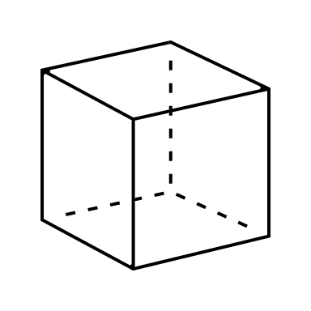

WHY OOP
The more you know about OOP, The more you can better leverage features of C# to build well-crafted, maintainable and testable application.
Code Reusability: Inheritance allows the reuse of code by creating derived classes from existing ones.

Slide 4
OOP Is the Foundation
OOP
Clean Code
Defensive Coding
Iterative Agile
API
SOLID Principles
Design Patterns
Domain Driven Design

Slide 5
public class Customer
{
public int CustomerId { get; private set; }
public string EmailAddress { get; set; }
public string FirstName { get; set; }
public string LastName { get; set; }
public bool Validate() {...}
}
We need to define the business objects
Business Object
Class
==

Slide 6
Entity

Slide 7
Customer Management System
Entity
Customer
Class
Customer
First Name
Last Name
Go On An Adventure
Objects
Mohammad Abo Tier
Eslam Hamed

Slide 8
What Is Object Oriented Programming (OOP)
An approach to designing and building applications that are:
Flexible
Natural
Well-crafted
Testable
by focusing on objects that interact cleanly with another
Identifying classes
Separating responsibilities
Establishing relationships
Leveraging reuse

Slide 9
How we extract classes from words
Analysis the business problem
Start with nouns
Define appropriate classes and members

Slide 10


Slide 11





Customer Management System
Manage regular, premium, VIP types of customer
Manage products
Receive orders from customers

Slide 12
Start with the Nouns
Customer
Product
Order
Manage regular, premium, VIP types of customer
Manage products
Receive orders from customers

Slide 13
Define Appropriate Members
Customer’s name (First name, Last name)
Contact information (phone number, email)
address
Product name
Product description
Product price
Order date
Total price
Shipping address

Slide 14
Define Appropriate Members
Customer
Name
Product
Name
Price
Order
Order date
Email
Phone
Address
Description
Shipping address
Product
Customer
Quantity

Slide 15
Define Appropriate Members
Customer
Name
Product
Name
Price
Order
Order date
Email
Phone
Address
Description
Shipping address
Order items
Customer
Order Item
Product
Quantity

Slide 16
Define Appropriate Members
Customer
Name
Product
Name
Price
Order
Order date
Email
Phone
Address
Description
Shipping address
Order items
Customer
Order Item
Product
Quantity
Validate()
Retrieve()
Save()
Validate()
Retrieve()
Save()
Validate()
Retrieve()
Save()
Validate()
Retrieve()
Save()

Slide 17
Consider Timing
Customer
Name
Product
Name
Price
Order
Order date
Email
Phone
Address
Description
Shipping address
Order items
Customer
Order Item
Product
Quantity
Validate()
Retrieve()
Save()
Validate()
Retrieve()
Save()
Validate()
Retrieve()
Save()
Validate()
Retrieve()
Save()
Purchase price

Slide 18
Abstraction
Abstraction is a fundamental concept in computer science that helps simplify complex systems, making them more manageable and easier to understand.
It allows to focus on essential aspects while hiding intricate details.
It aims to capture the essential functionalities and characteristics while hiding unnecessary details.
The way you think about classes, and not a programming technique.

Slide 19
Encapsulation
Encapsulation is a key underlaying principle that makes to possible to build large, full-featured system by breaking complex operations into encapsulated units (classes).
Encapsulation allows the objects in an application to work together without knowing the details of other object’s implementation.

Slide 20



Benefits of hiding data and implementation within the class
Protects the data
Allows for authorization before getting the data
Allows for validation before setting the data
Helps manage complexity by breaking methods down into manageable units
Only the class understand the implementation.
Implementation can be changing without impacting the rest of application.
Notes:
The code is easier to modify and test because the implementation is encapsulated in one place. Example 1: if we go to amazon and order a product you don’t need to know anything about where or how the product is stored or how is processed.

Slide 21


Common Application layers
User interface layer
Business logic layer
Data access layer
Common Code
Notes:
Most applications are minimally divided into 3 layers.
Data access layer contains the code to retrieve the data from the database or other data store and save data back to that data store.
this layer usually contains EF code if used.
Many application include a common library for general purpose code like logging or sending emails.

Slide 22
The time for writing some code

Slide 23
Separation of concerns

Slide 24

Separation of concerns
Minimizing coupling
Maximizing cohesion
Simplifies maintenance
Improve testability

Slide 25
Separating of responsibilities
Customer
Name
Address
City
Country
Email
Phone
Home Address
State
Validate()
Retrieve()
Save()
Validate()
Postal Code
Work Address
Address Type
YAGNI

Slide 26
Separating of responsibilities
Customer
Name
Address
City
Country
Email
Phone
Home Address
State
Validate()
Retrieve()
Save()
Validate()
Postal Code
Work Address
Address Type
Customer Repository
Retrieve()
Save()

Slide 27
Separating of responsibilities
Customer
Name
Product
Name
Price
Order
Order date
Email
Phone
Work Address
Description
Shipping address
Order items
Customer
Order Item
Product
Quantity
Validate()
Validate()
Validate()
Validate()
Purchase price
Home Address
Customer Repository
Retrieve()
Product Repository
Retrieve()
Order Repository
Retrieve()
Address
City
Save()
Save()
Save()
State
Country
Postal Code
Address Type
Validate()

Slide 28
Establishing Relationships

Slide 29
Working Together
Application
Business logic layer
User Interface layer
Order Repository (OR) class
Order (O) class
Order Summary Form
O
OR
Order Item (OI) class
OI
OI
OI

Slide 30
Types of Relationships
Collaboration (uses a”)
Composition (“has a”)
Aggregation
Composition
Inheritance (“is a”)
Customer Repository
Order
Customer
Customer
Customer
Order Item
Address
Order
Customer
Order
Order
Order Items

Slide 31
Thank you !

